Slide 1
Downloading R and Rstudio
Step by step (windows)

Slide 2
1. To install R, go to cran.r-project.org
Open your web browser and go to the R Project website: https://cran.r-project.org/.

Slide 3
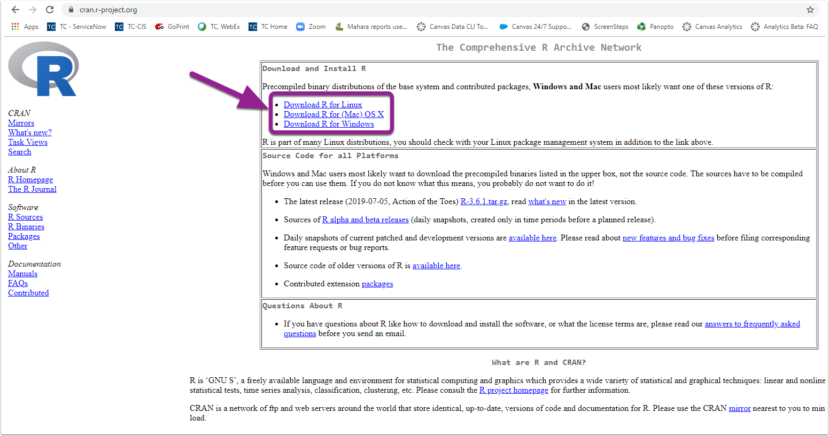
2. Depending on your operating system, click Download R for your operating system.

Slide 4
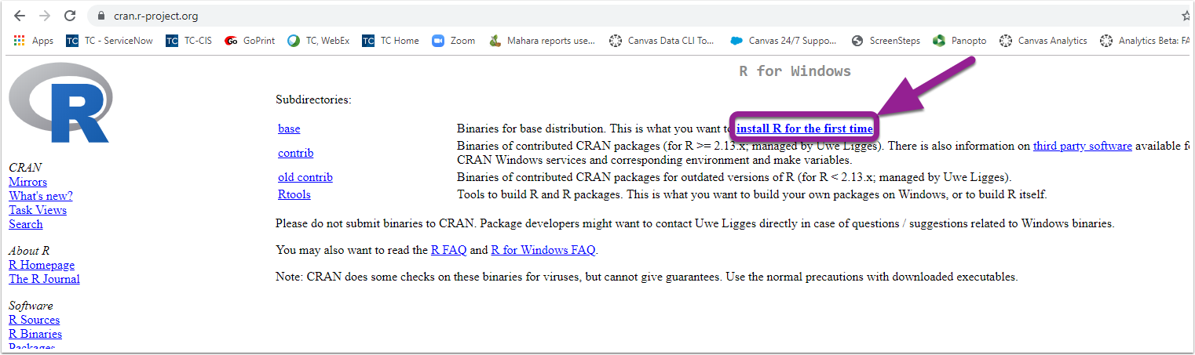
3. Click on install R for the first time.

Slide 5
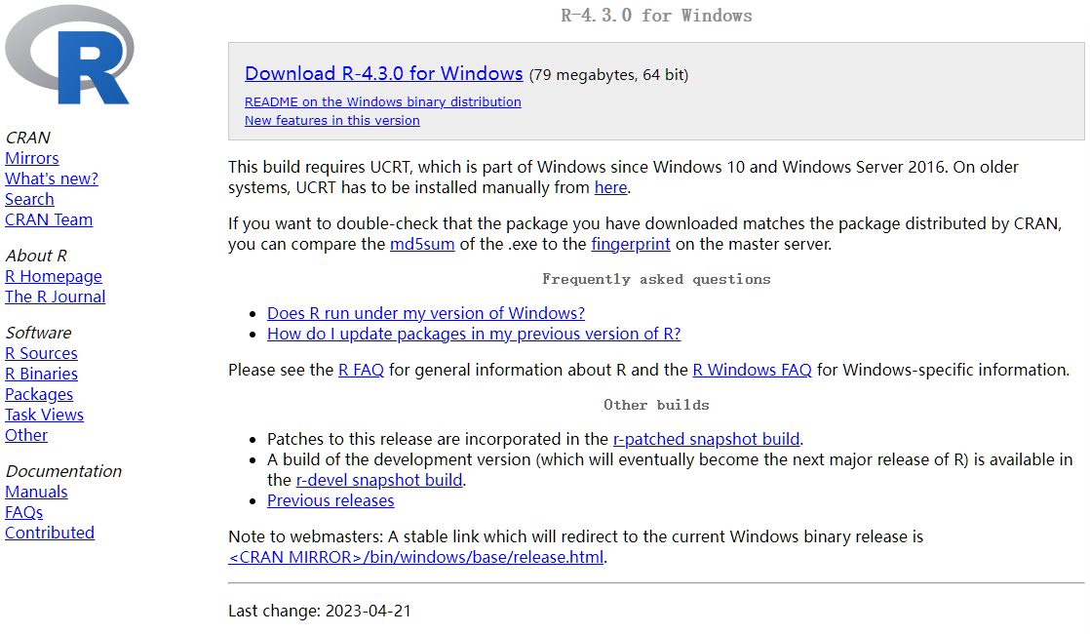
4. Click Download R for Windows. Open the downloaded file.

Slide 6
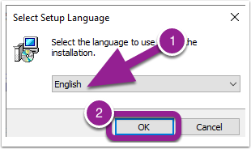
5. Select the language you would like to use during the installation. Then click OK.

Slide 7
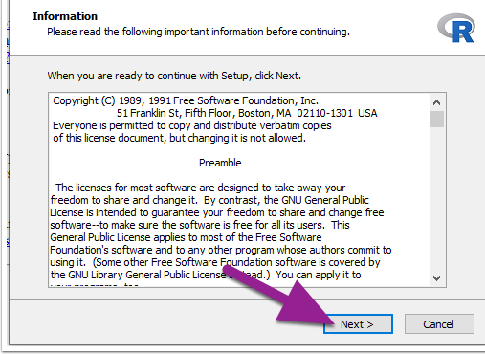
6. Click Next.

Slide 8
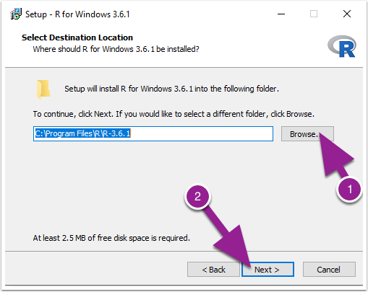
7. Select where you would like R to be installed. It will default to your Program Files on your C Drive. Click Next.

Slide 9
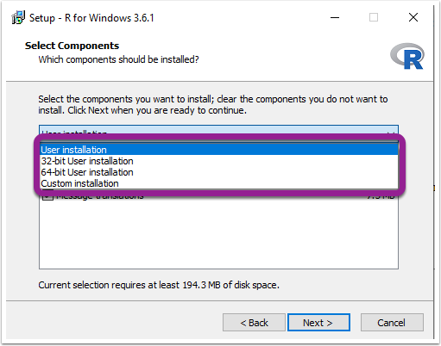
8. You can then choose which installation you would like.

Slide 10
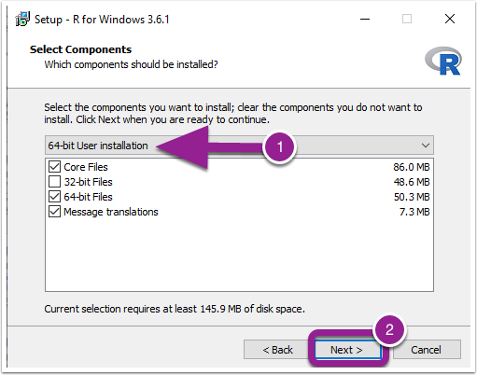
9. (Optional) If your computer is a 64-bit, you can choose the 64-bit User Installation. Then click Next.

Slide 11
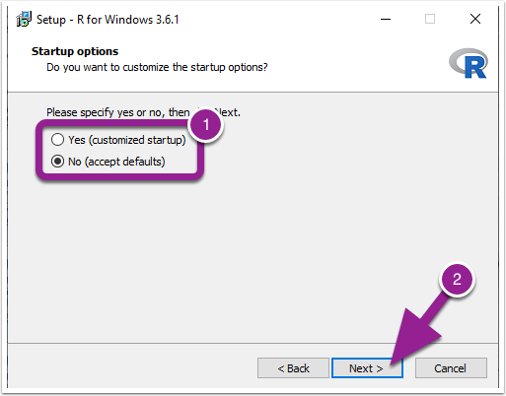
10. Then specify if you want to customized your startup or just use the defaults. Then click Next.

Slide 12
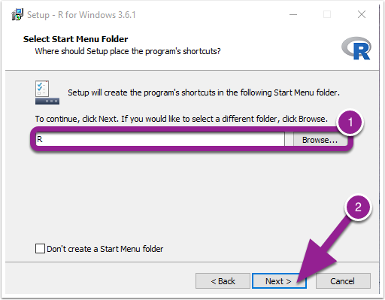
11. Then you can choose the folder that you want R to be saved within or the default if the R folder that was created. &nbsp;Once you have finished, click Next.

Slide 13
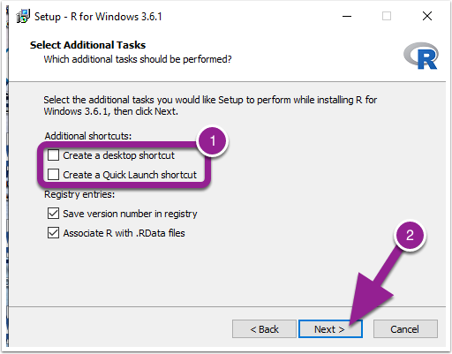
12. You can then select additional shortcuts if you would like. Click Next. Then finish.

Slide 14
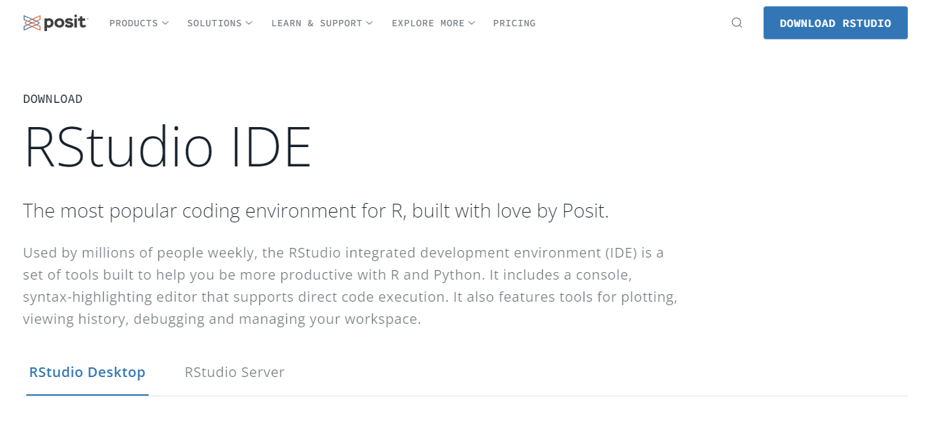
13. Next, download RStudio. Go to www.rstudio.com, Click Download RStudio.

Slide 15
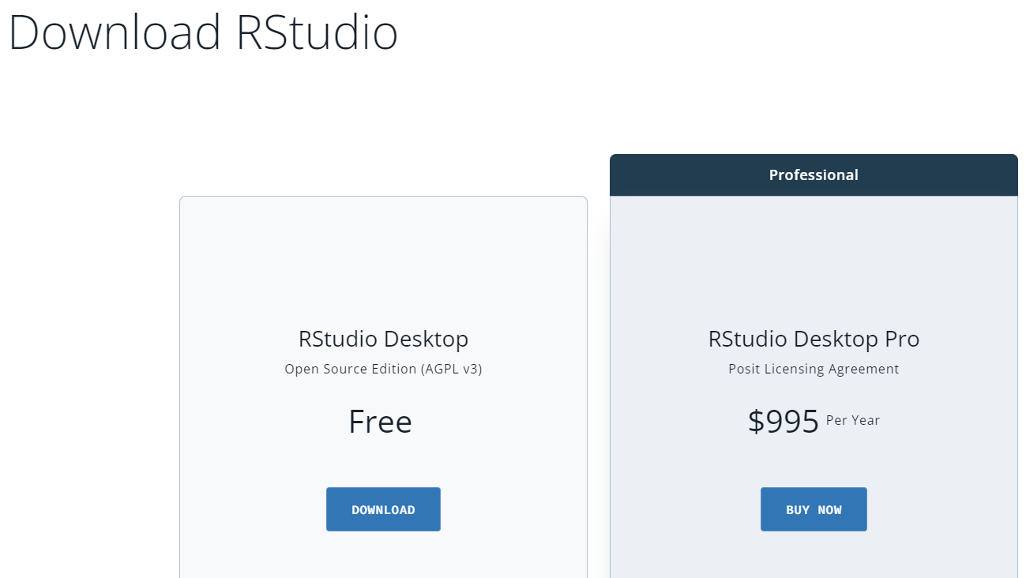
14. Click Download under RStudio Desktop- Open Source Edition

Slide 16
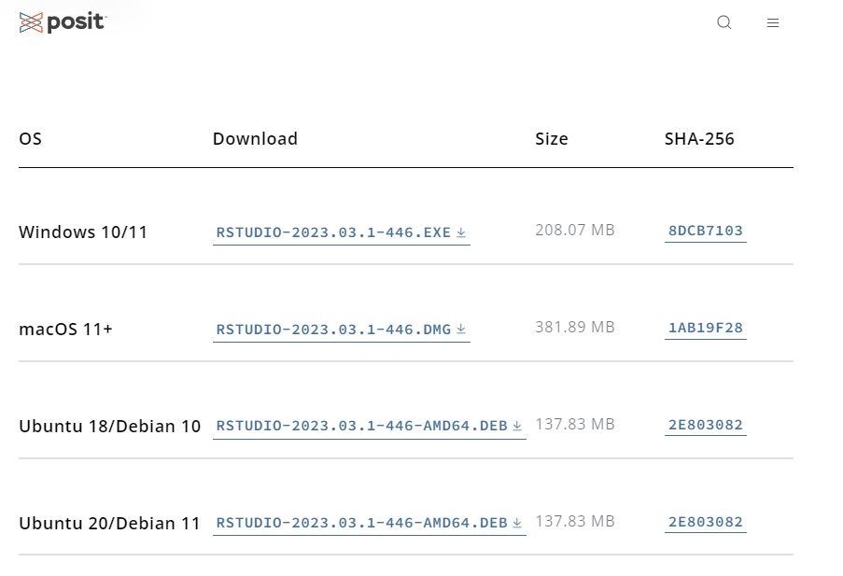
15. Click on the operating system that you are working with.

Slide 17
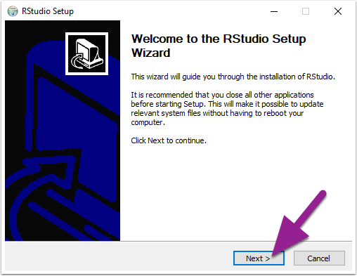
16. The RStudio installation wizard will pop-up. Click Next and go through the installation steps.

Slide 18
17. Congratulations! You have now installed R and RStudio.

